Slide 1

Notes:
Ilé
INVESTOR PRESENTATION
RAISING
Care for the last years
of life in Lagos, built for $500k
pre-seed for 30%, for ₦3.12bn of revenue
families abroad. at 32% EBITDA in year five.
Care at home, a care home and a mortuary: three businesses that follow one
family, run on one record.
DATE CONTACT NAME
October 2026 kemotoks@hotmail.com Ilé is a working name

Slide 2
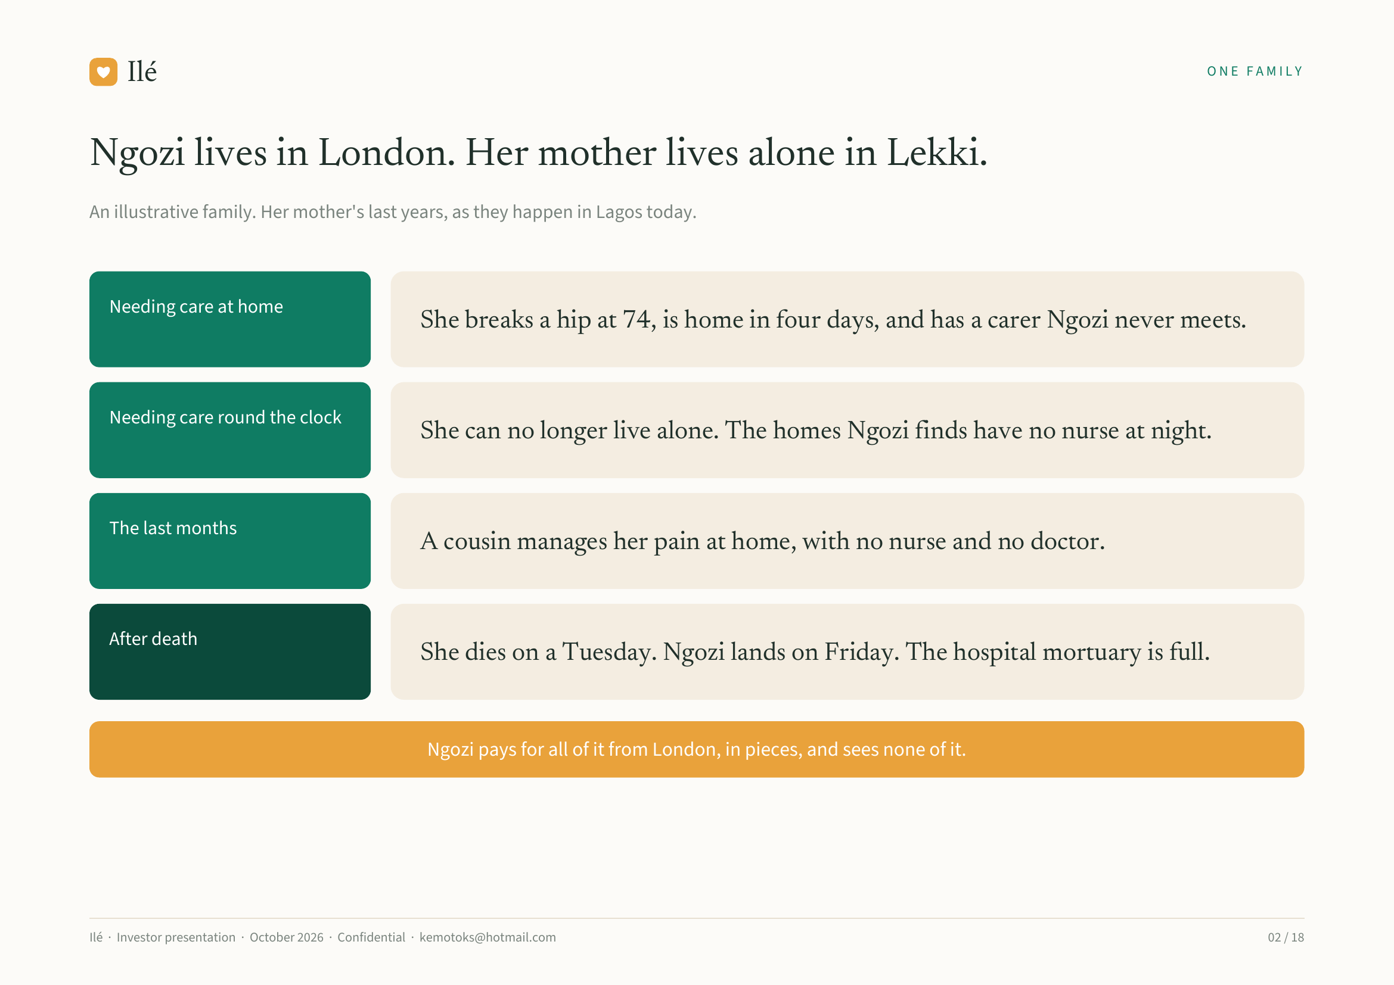
Notes:
Ilé ONE FAMILY
Ngozi lives in London. Her mother lives alone in Lekki.
An illustrative family. Her mother's last years, as they happen in Lagos today.
Needing care at home
She breaks a hip at 74, is home in four days, and has a carer Ngozi never meets.
Needing care round the clock
She can no longer live alone. The homes Ngozi finds have no nurse at night.
The last months
A cousin manages her pain at home, with no nurse and no doctor.
After death
She dies on a Tuesday. Ngozi lands on Friday. The hospital mortuary is full.
Ngozi pays for all of it from London, in pieces, and sees none of it.
Ilé · Investor presentation · October 2026 · Confidential · kemotoks@hotmail.com 02 / 18

Slide 3
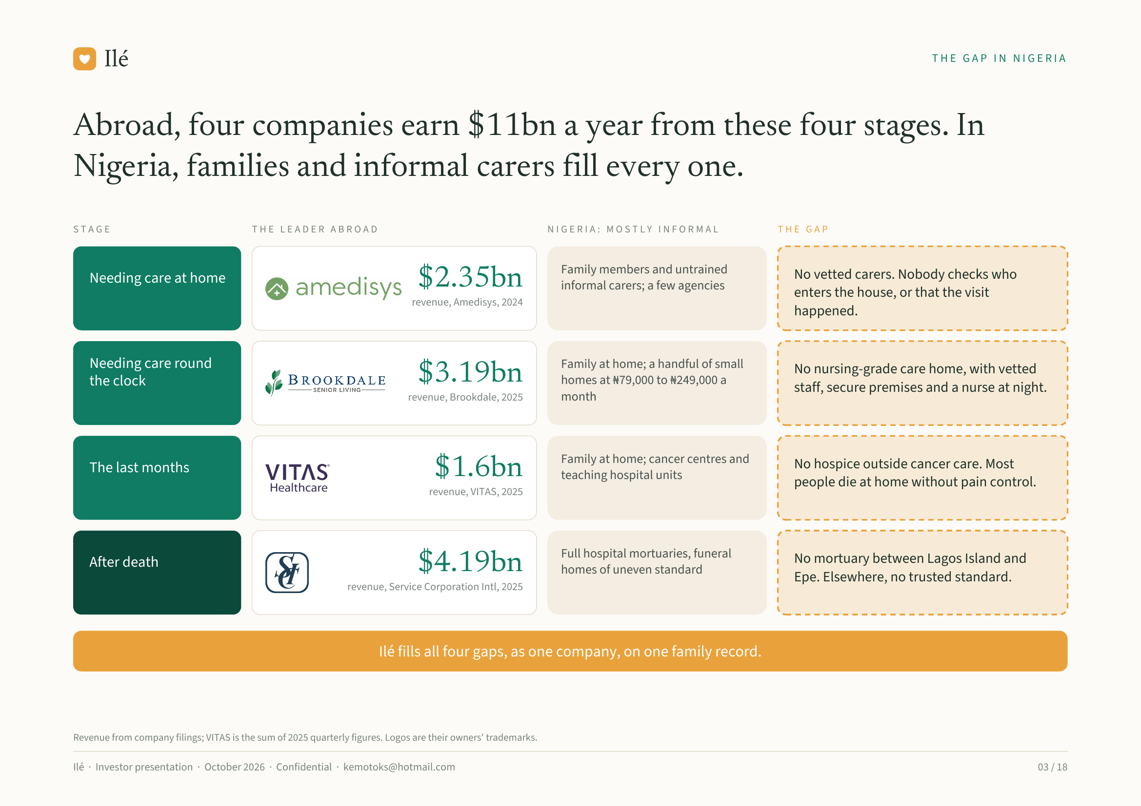
Notes:
Ilé THE GAP IN NIGERIA
Abroad, four companies earn $11bn a year from these four stages. In
Nigeria, families and informal carers fill every one.
STAGE THE LEADER ABROAD NIGERIA: MOSTLY INFORMAL THE GAP
Family members and untrained No vetted carers. Nobody checks who
Needing care at home $2.35bn informal carers; a few agencies
enters the house, or that the visit
revenue, Amedisys, 2024
happened.
Needing care round Family at home; a handful of small No nursing-grade care home, with vetted
the clock $3.19bn homes at ₦79,000 to ₦249,000 a
staff, secure premises and a nurse at night.
revenue, Brookdale, 2025 month
Family at home; cancer centres and No hospice outside cancer care. Most
The last months $1.6bn teaching hospital units
people die at home without pain control.
revenue, VITAS, 2025
Full hospital mortuaries, funeral No mortuary between Lagos Island and
After death $4.19bn homes of uneven standard
Epe. Elsewhere, no trusted standard.
revenue, Service Corporation Intl, 2025
Ilé fills all four gaps, as one company, on one family record.
Revenue from company filings; VITAS is the sum of 2025 quarterly figures. Logos are their owners' trademarks.
Ilé · Investor presentation · October 2026 · Confidential · kemotoks@hotmail.com 03 / 18

Slide 4
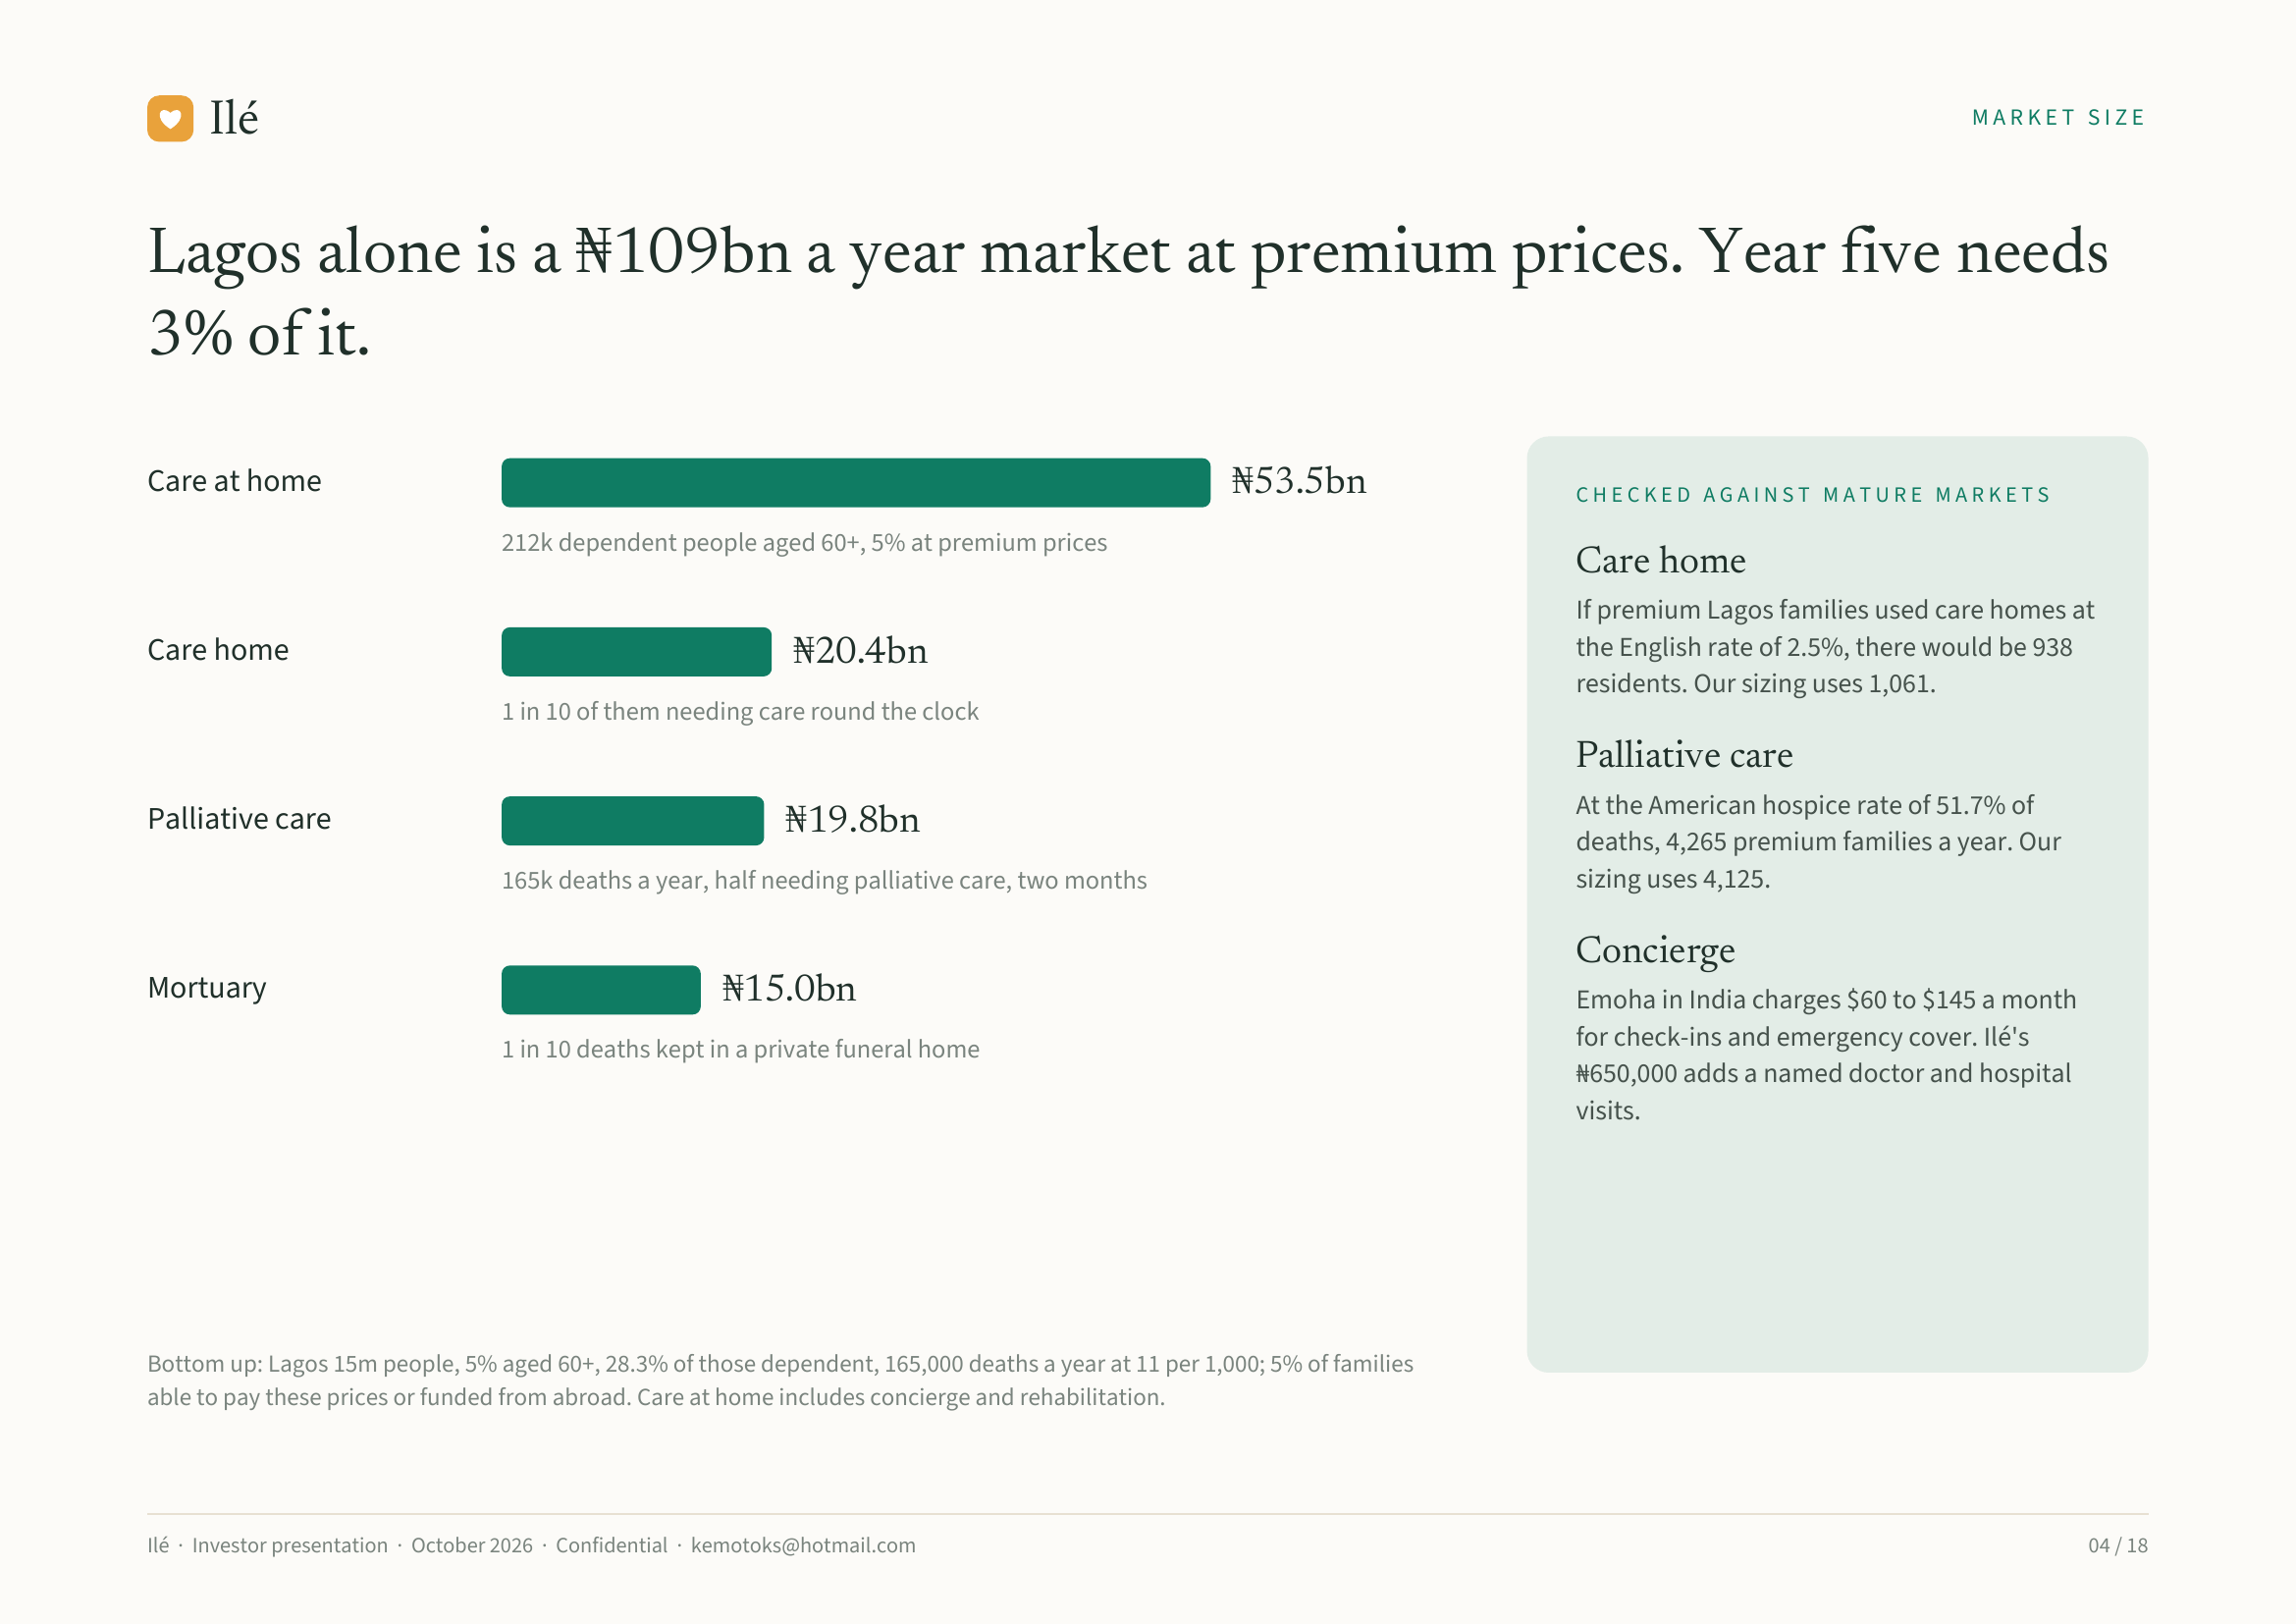
Notes:
Ilé MARKET SIZE
Lagos alone is a ₦109bn a year market at premium prices. Year five needs
3% of it.
Care at home ₦53.5bn CHECKED AGAINST MATURE MARKETS
212k dependent people aged 60+, 5% at premium prices
Care home
If premium Lagos families used care homes at
Care home ₦20.4bn the English rate of 2.5%, there would be 938
residents. Our sizing uses 1,061.
1 in 10 of them needing care round the clock
Palliative care
At the American hospice rate of 51.7% of
Palliative care ₦19.8bn deaths, 4,265 premium families a year. Our
165k deaths a year, half needing palliative care, two months sizing uses 4,125.
Concierge
Mortuary ₦15.0bn Emoha in India charges $60 to $145 a month
1 in 10 deaths kept in a private funeral home for check-ins and emergency cover. Ilé's
₦650,000 adds a named doctor and hospital
visits.
Bottom up: Lagos 15m people, 5% aged 60+, 28.3% of those dependent, 165,000 deaths a year at 11 per 1,000; 5% of families
able to pay these prices or funded from abroad. Care at home includes concierge and rehabilitation.
Ilé · Investor presentation · October 2026 · Confidential · kemotoks@hotmail.com 04 / 18

Slide 5
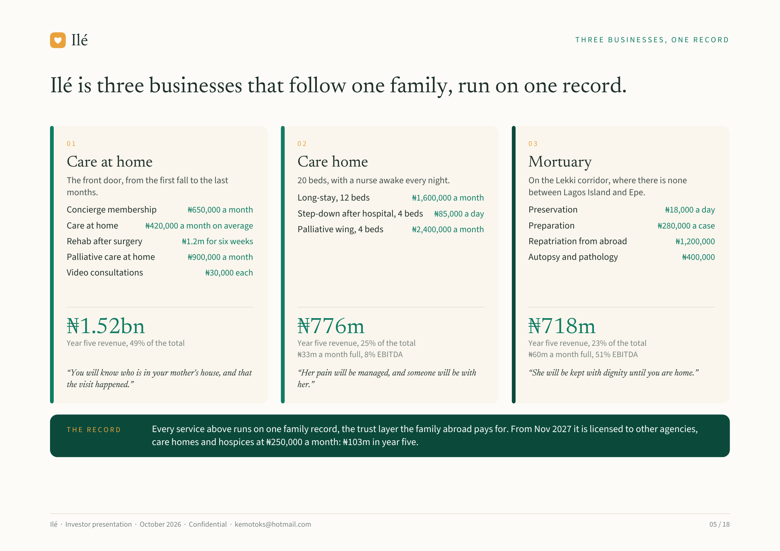
Notes:
Ilé THREE BUSINESSES, ONE RECORD
Ilé is three businesses that follow one family, run on one record.
01 02 03
Care at home Care home Mortuary
The front door, from the first fall to the last 20 beds, with a nurse awake every night. On the Lekki corridor, where there is none
months. between Lagos Island and Epe.
Long-stay, 12 beds ₦1,600,000 a month
Concierge membership ₦650,000 a month Step-down after hospital, 4 beds ₦85,000 a day Preservation ₦18,000 a day
Care at home ₦420,000 a month on average Palliative wing, 4 beds ₦2,400,000 a month Preparation ₦280,000 a case
Rehab after surgery ₦1.2m for six weeks Repatriation from abroad ₦1,200,000
Palliative care at home ₦900,000 a month Autopsy and pathology ₦400,000
Video consultations ₦30,000 each
₦1.52bn ₦776m ₦718m
Year five revenue, 49% of the total Year five revenue, 25% of the total Year five revenue, 23% of the total
₦33m a month full, 8% EBITDA ₦60m a month full, 51% EBITDA
“You will know who is in your mother's house, and that “Her pain will be managed, and someone will be with “She will be kept with dignity until you are home.”
the visit happened.” her.”
THE RECORD Every service above runs on one family record, the trust layer the family abroad pays for. From Nov 2027 it is licensed to other agencies,
care homes and hospices at ₦250,000 a month: ₦103m in year five.
Ilé · Investor presentation · October 2026 · Confidential · kemotoks@hotmail.com 05 / 18

Slide 6
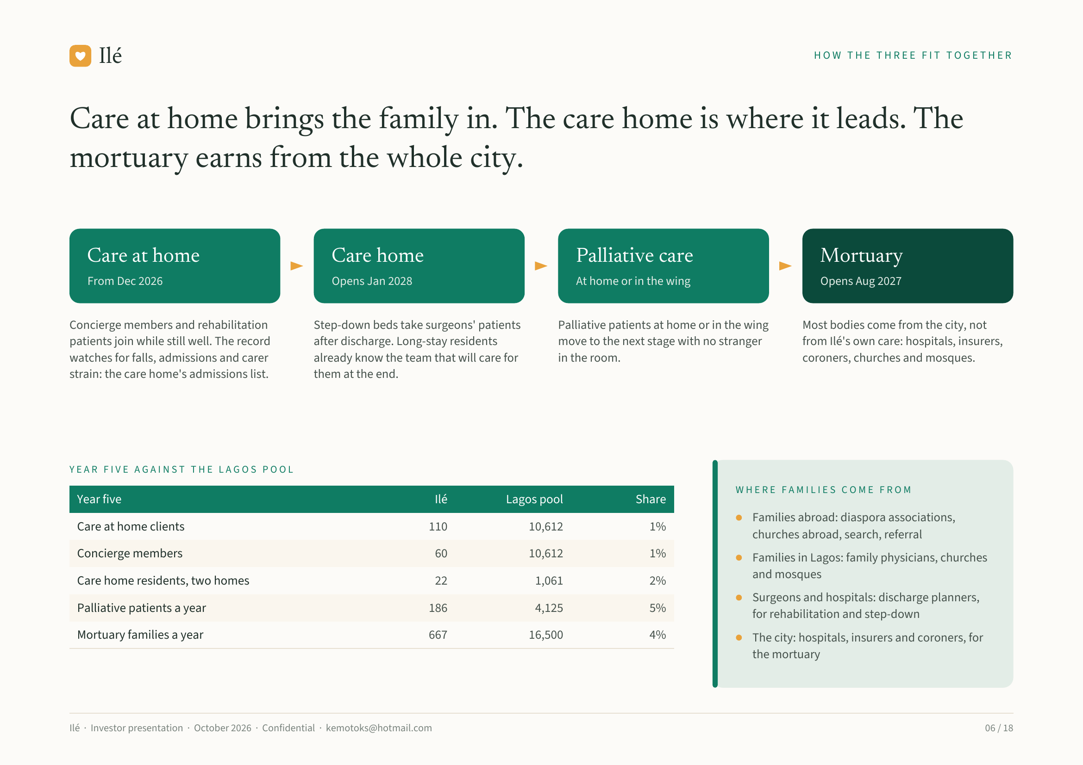
Notes:
Ilé HOW THE THREE FIT TOGETHER
Care at home brings the family in. The care home is where it leads. The
mortuary earns from the whole city.
Care at home Care home Palliative care Mortuary
From Dec 2026 Opens Jan 2028 At home or in the wing Opens Aug 2027
Concierge members and rehabilitation Step-down beds take surgeons' patients Palliative patients at home or in the wing Most bodies come from the city, not
patients join while still well. The record after discharge. Long-stay residents move to the next stage with no stranger from Ilé's own care: hospitals, insurers,
watches for falls, admissions and carer already know the team that will care for in the room. coroners, churches and mosques.
strain: the care home's admissions list. them at the end.
YEAR FIVE AGAINST THE LAGOS POOL
WHERE FAMILIES COME FROM
Year five Ilé Lagos pool Share
Families abroad: diaspora associations,
Care at home clients 110 10,612 1%
churches abroad, search, referral
Concierge members 60 10,612 1% Families in Lagos: family physicians, churches
and mosques
Care home residents, two homes 22 1,061 2%
Surgeons and hospitals: discharge planners,
Palliative patients a year 186 4,125 5%
for rehabilitation and step-down
Mortuary families a year 667 16,500 4% The city: hospitals, insurers and coroners, for
the mortuary
Ilé · Investor presentation · October 2026 · Confidential · kemotoks@hotmail.com 06 / 18

Slide 7
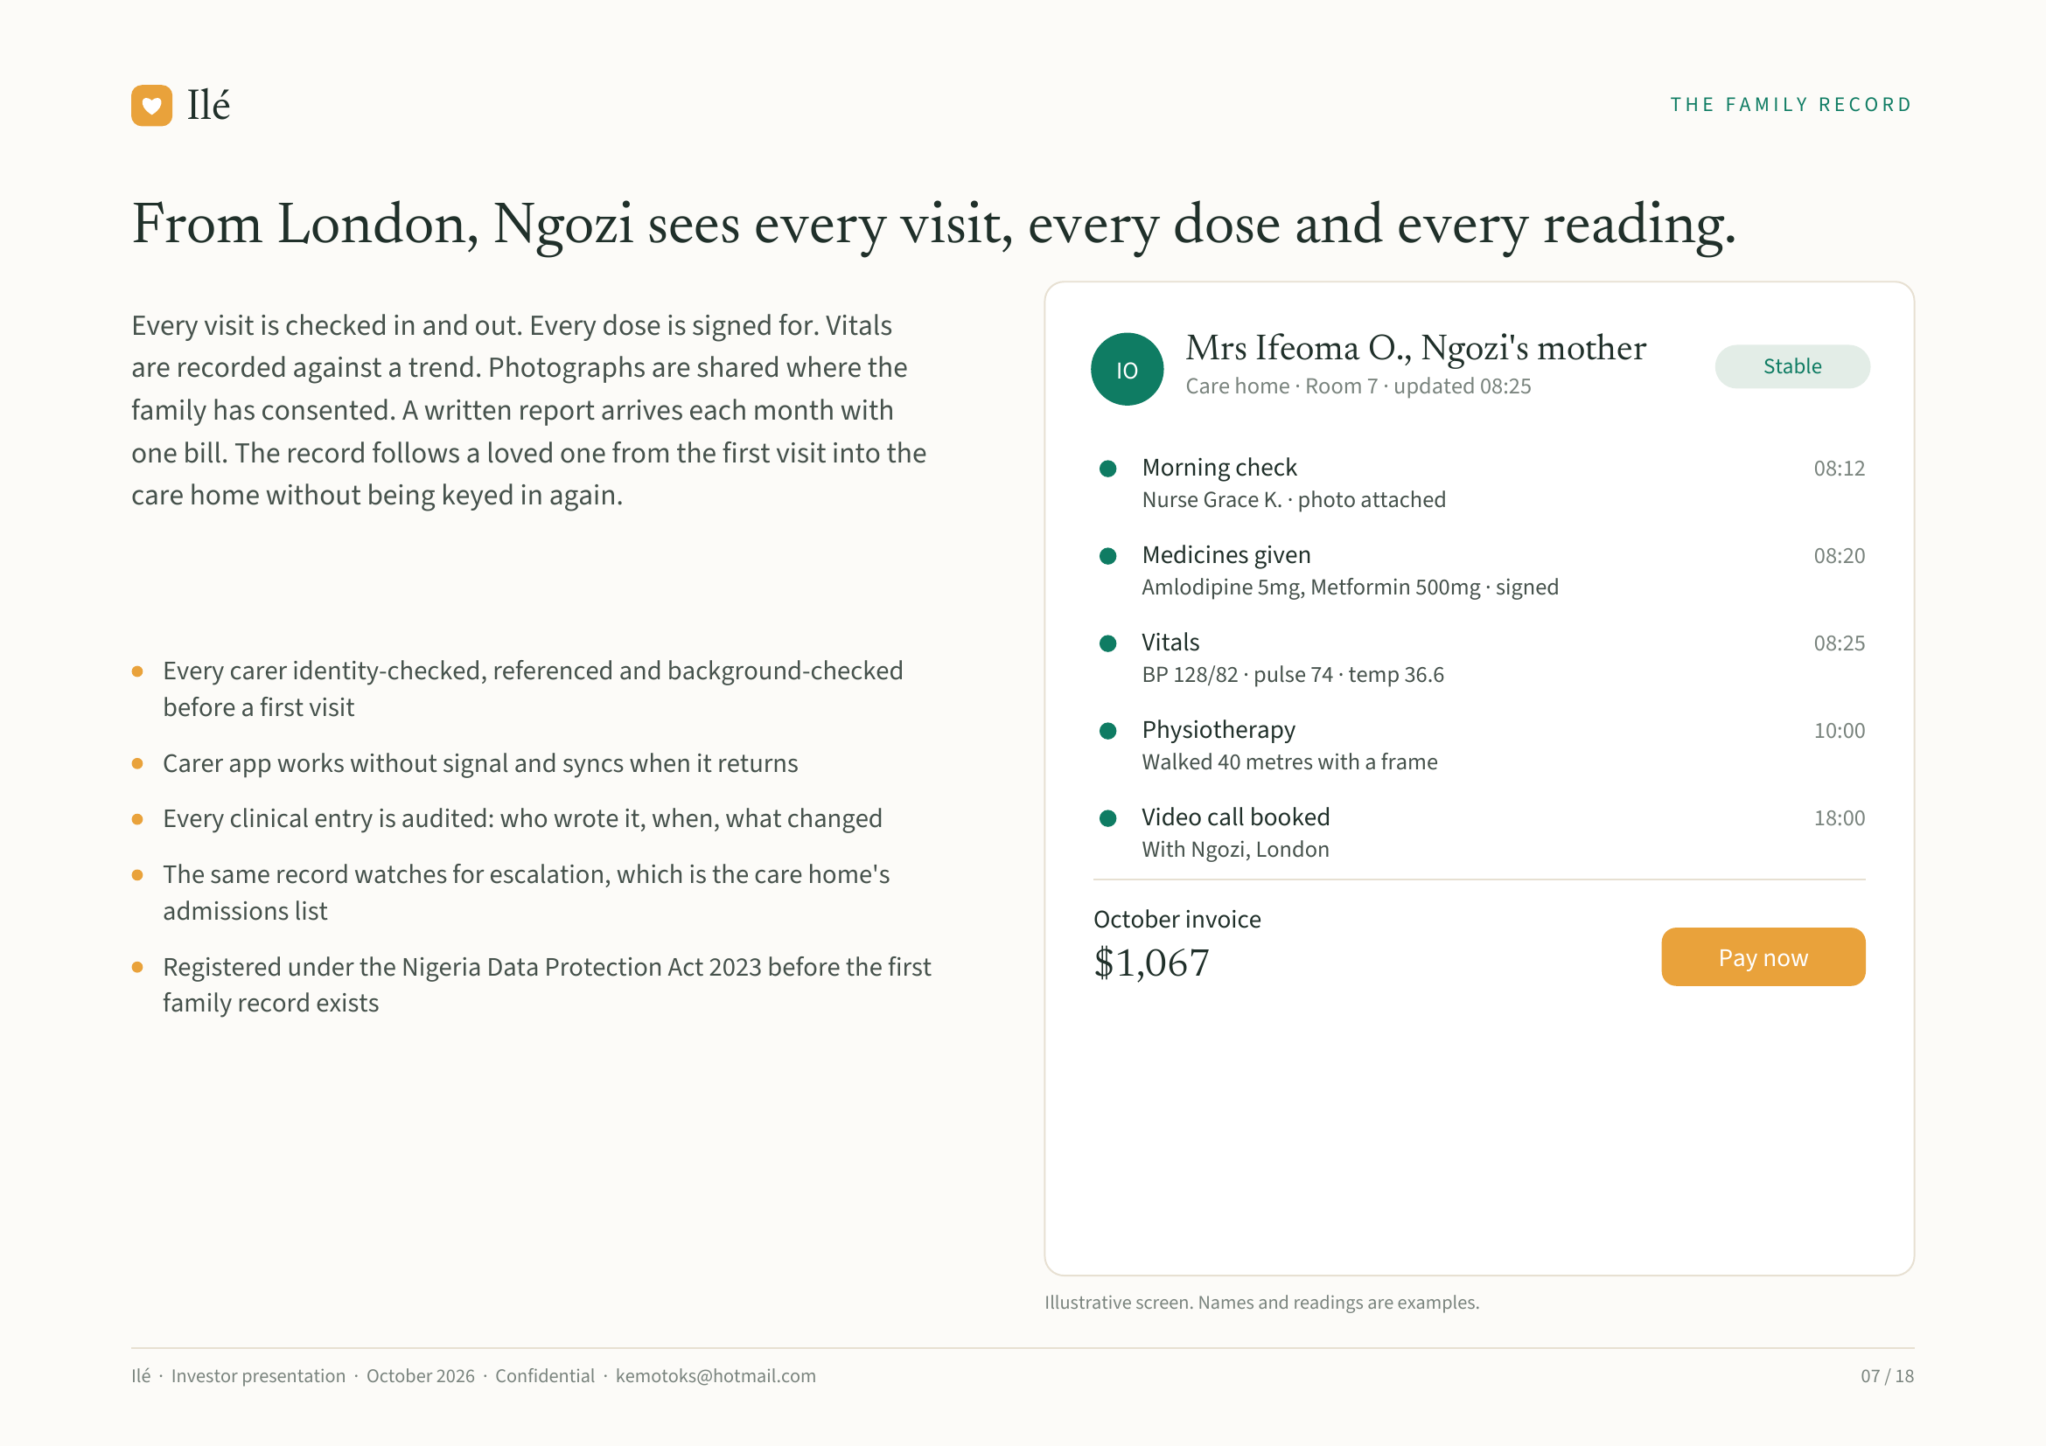
Notes:
Ilé THE FAMILY RECORD
From London, Ngozi sees every visit, every dose and every reading.
Every visit is checked in and out. Every dose is signed for. Vitals
Mrs Ifeoma O., Ngozi's mother
are recorded against a trend. Photographs are shared where the IO Stable
Care home · Room 7 · updated 08:25
family has consented. A written report arrives each month with
one bill. The record follows a loved one from the first visit into the Morning check 08:12
care home without being keyed in again. Nurse Grace K. · photo attached
Medicines given 08:20
Amlodipine 5mg, Metformin 500mg · signed
Vitals 08:25
Every carer identity-checked, referenced and background-checked BP 128/82 · pulse 74 · temp 36.6
before a first visit
Physiotherapy 10:00
Carer app works without signal and syncs when it returns Walked 40 metres with a frame
Every clinical entry is audited: who wrote it, when, what changed Video call booked 18:00
With Ngozi, London
The same record watches for escalation, which is the care home's
admissions list October invoice
Registered under the Nigeria Data Protection Act 2023 before the first $1,067 Pay now
family record exists
Illustrative screen. Names and readings are examples.
Ilé · Investor presentation · October 2026 · Confidential · kemotoks@hotmail.com 07 / 18

Slide 8
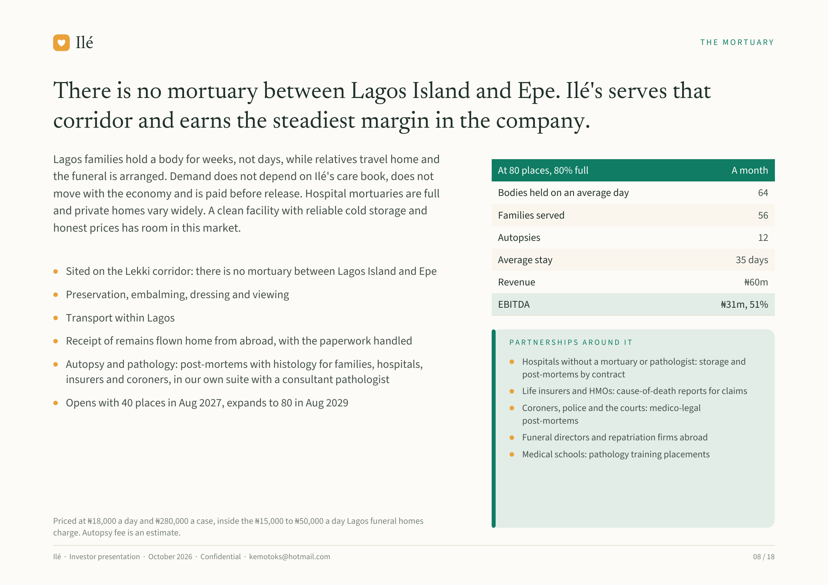
Notes:
Ilé THE MORTUARY
There is no mortuary between Lagos Island and Epe. Ilé's serves that
corridor and earns the steadiest margin in the company.
Lagos families hold a body for weeks, not days, while relatives travel home and
At 80 places, 80% full A month
the funeral is arranged. Demand does not depend on Ilé's care book, does not
move with the economy and is paid before release. Hospital mortuaries are full Bodies held on an average day 64
and private homes vary widely. A clean facility with reliable cold storage and Families served 56
honest prices has room in this market.
Autopsies 12
Average stay 35 days
Sited on the Lekki corridor: there is no mortuary between Lagos Island and Epe
Revenue ₦60m
Preservation, embalming, dressing and viewing
EBITDA ₦31m, 51%
Transport within Lagos
Receipt of remains flown home from abroad, with the paperwork handled PARTNERSHIPS AROUND IT
Autopsy and pathology: post-mortems with histology for families, hospitals, Hospitals without a mortuary or pathologist: storage and
post-mortems by contract
insurers and coroners, in our own suite with a consultant pathologist
Life insurers and HMOs: cause-of-death reports for claims
Opens with 40 places in Aug 2027, expands to 80 in Aug 2029 Coroners, police and the courts: medico-legal
post-mortems
Funeral directors and repatriation firms abroad
Medical schools: pathology training placements
Priced at ₦18,000 a day and ₦280,000 a case, inside the ₦15,000 to ₦50,000 a day Lagos funeral homes
charge. Autopsy fee is an estimate.
Ilé · Investor presentation · October 2026 · Confidential · kemotoks@hotmail.com 08 / 18

Slide 9
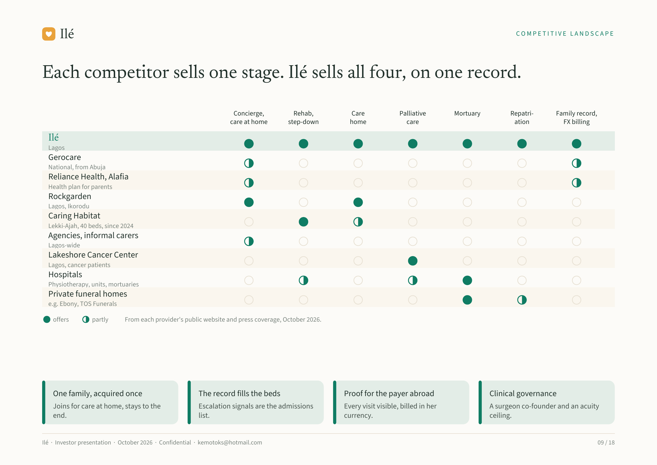
Notes:
Ilé COMPETITIVE LANDSCAPE
Each competitor sells one stage. Ilé sells all four, on one record.
Concierge, Rehab, Care Palliative Mortuary Repatri- Family record,
care at home step-down home care ation FX billing
Ilé
Lagos
Gerocare
National, from Abuja
Reliance Health, Alafia
Health plan for parents
Rockgarden
Lagos, Ikorodu
Caring Habitat
Lekki-Ajah, 40 beds, since 2024
Agencies, informal carers
Lagos-wide
Lakeshore Cancer Center
Lagos, cancer patients
Hospitals
Physiotherapy, units, mortuaries
Private funeral homes
e.g. Ebony, TOS Funerals
offers partly From each provider's public website and press coverage, October 2026.
One family, acquired once The record fills the beds Proof for the payer abroad Clinical governance
Joins for care at home, stays to the Escalation signals are the admissions Every visit visible, billed in her A surgeon co-founder and an acuity
end. list. currency. ceiling.
Ilé · Investor presentation · October 2026 · Confidential · kemotoks@hotmail.com 09 / 18

Slide 10
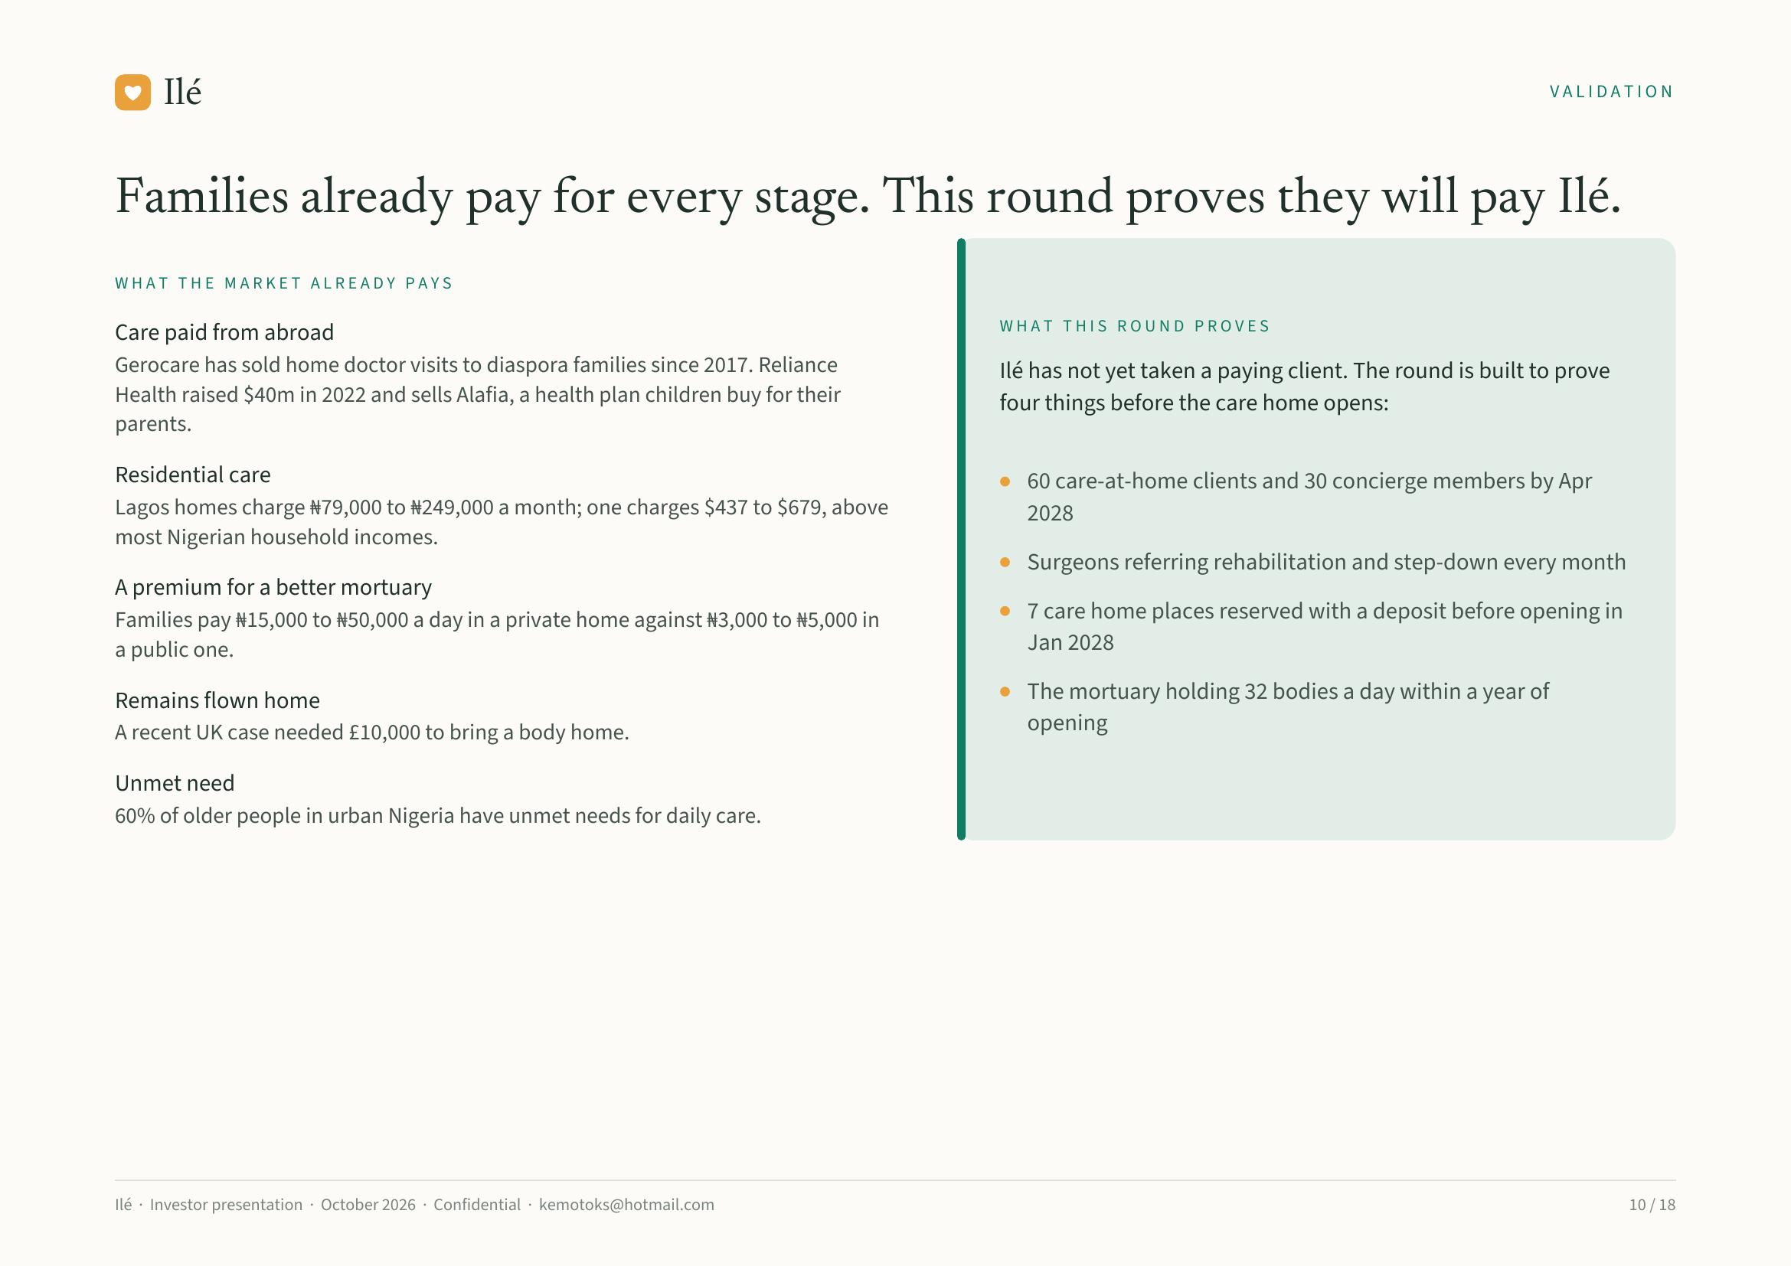
Notes:
Ilé VALIDATION
Families already pay for every stage. This round proves they will pay Ilé.
WHAT THE MARKET ALREADY PAYS
WHAT THIS ROUND PROVES
Care paid from abroad
Gerocare has sold home doctor visits to diaspora families since 2017. Reliance Ilé has not yet taken a paying client. The round is built to prove
Health raised $40m in 2022 and sells Alafia, a health plan children buy for their four things before the care home opens:
parents.
Residential care 60 care-at-home clients and 30 concierge members by Apr
Lagos homes charge ₦79,000 to ₦249,000 a month; one charges $437 to $679, above 2028
most Nigerian household incomes.
Surgeons referring rehabilitation and step-down every month
A premium for a better mortuary
Families pay ₦15,000 to ₦50,000 a day in a private home against ₦3,000 to ₦5,000 in 7 care home places reserved with a deposit before opening in
a public one. Jan 2028
Remains flown home The mortuary holding 32 bodies a day within a year of
A recent UK case needed £10,000 to bring a body home. opening
Unmet need
60% of older people in urban Nigeria have unmet needs for daily care.
Ilé · Investor presentation · October 2026 · Confidential · kemotoks@hotmail.com 10 / 18

Slide 11
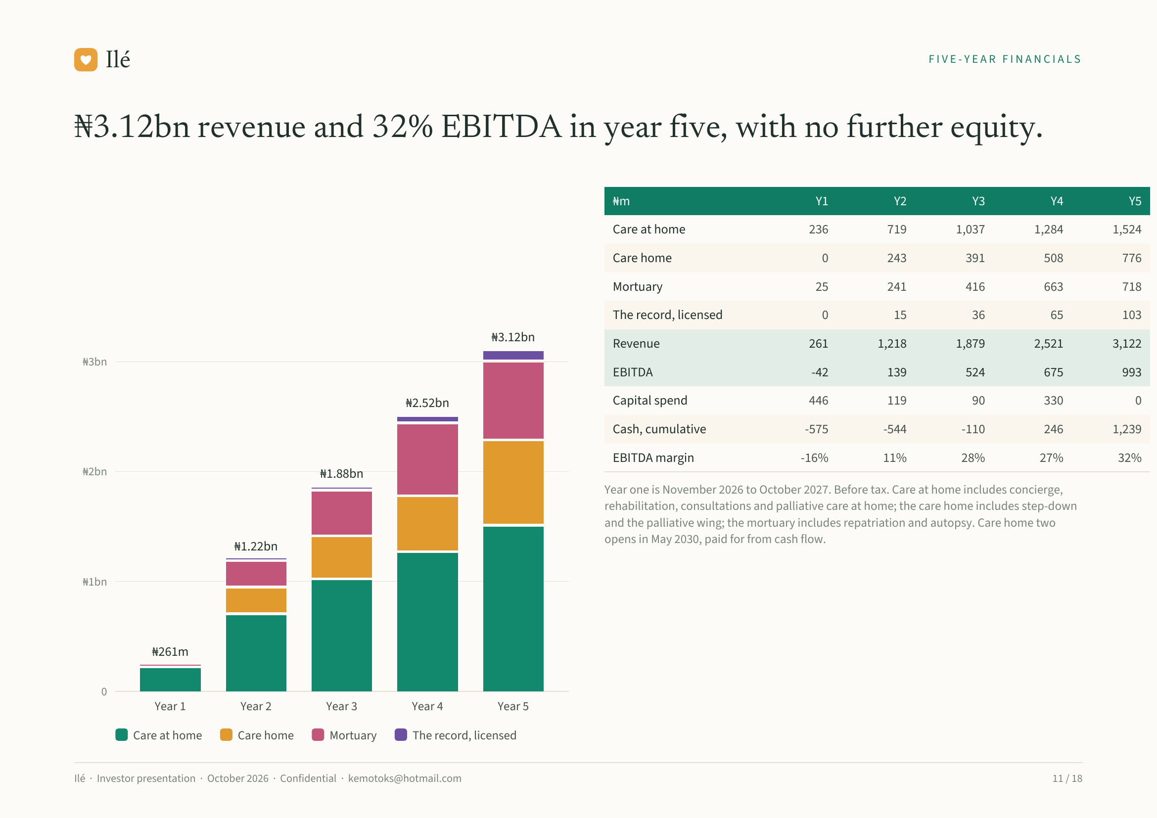
Notes:
Ilé FIVE-YEAR FINANCIALS
₦3.12bn revenue and 32% EBITDA in year five, with no further equity.
₦m Y1 Y2 Y3 Y4 Y5
Care at home 236 719 1,037 1,284 1,524
Care home 0 243 391 508 776
Mortuary 25 241 416 663 718
The record, licensed 0 15 36 65 103
₦3.12bn Revenue 261 1,218 1,879 2,521 3,122
₦3bn
EBITDA -42 139 524 675 993
₦2.52bn Capital spend 446 119 90 330 0
Cash, cumulative -575 -544 -110 246 1,239
EBITDA margin -16% 11% 28% 27% 32%
₦2bn ₦1.88bn
Year one is November 2026 to October 2027. Before tax. Care at home includes concierge,
rehabilitation, consultations and palliative care at home; the care home includes step-down
and the palliative wing; the mortuary includes repatriation and autopsy. Care home two
opens in May 2030, paid for from cash flow.
₦1.22bn
₦1bn
₦261m
0
Year 1 Year 2 Year 3 Year 4 Year 5
Care at home Care home Mortuary The record, licensed
Ilé · Investor presentation · October 2026 · Confidential · kemotoks@hotmail.com 11 / 18

Slide 12
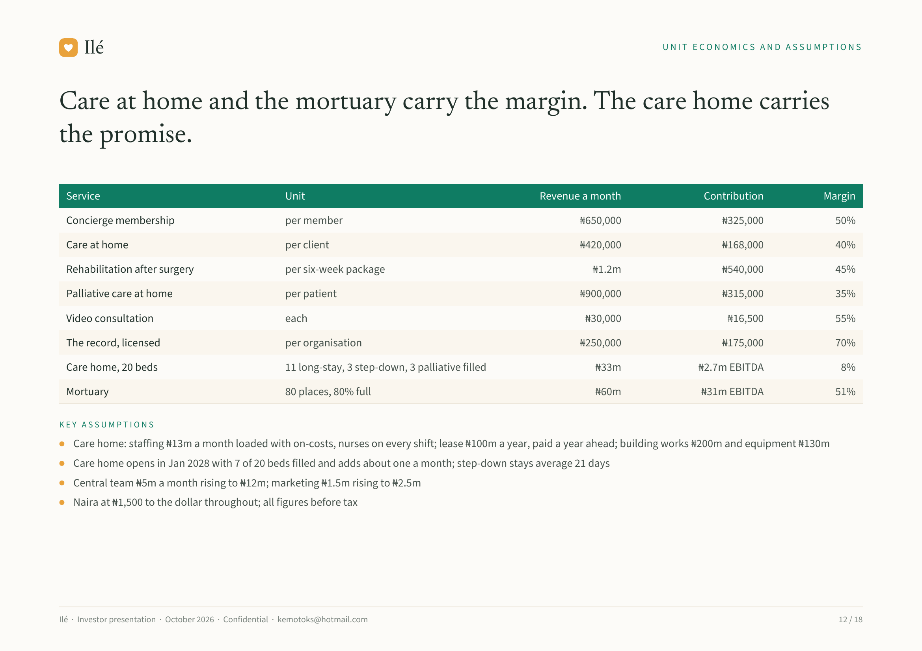
Notes:
Ilé UNIT ECONOMICS AND ASSUMPTIONS
Care at home and the mortuary carry the margin. The care home carries
the promise.
Service Unit Revenue a month Contribution Margin
Concierge membership per member ₦650,000 ₦325,000 50%
Care at home per client ₦420,000 ₦168,000 40%
Rehabilitation after surgery per six-week package ₦1.2m ₦540,000 45%
Palliative care at home per patient ₦900,000 ₦315,000 35%
Video consultation each ₦30,000 ₦16,500 55%
The record, licensed per organisation ₦250,000 ₦175,000 70%
Care home, 20 beds 11 long-stay, 3 step-down, 3 palliative filled ₦33m ₦2.7m EBITDA 8%
Mortuary 80 places, 80% full ₦60m ₦31m EBITDA 51%
KEY ASSUMPTIONS
Care home: staffing ₦13m a month loaded with on-costs, nurses on every shift; lease ₦100m a year, paid a year ahead; building works ₦200m and equipment ₦130m
Care home opens in Jan 2028 with 7 of 20 beds filled and adds about one a month; step-down stays average 21 days
Central team ₦5m a month rising to ₦12m; marketing ₦1.5m rising to ₦2.5m
Naira at ₦1,500 to the dollar throughout; all figures before tax
Ilé · Investor presentation · October 2026 · Confidential · kemotoks@hotmail.com 12 / 18

Slide 13
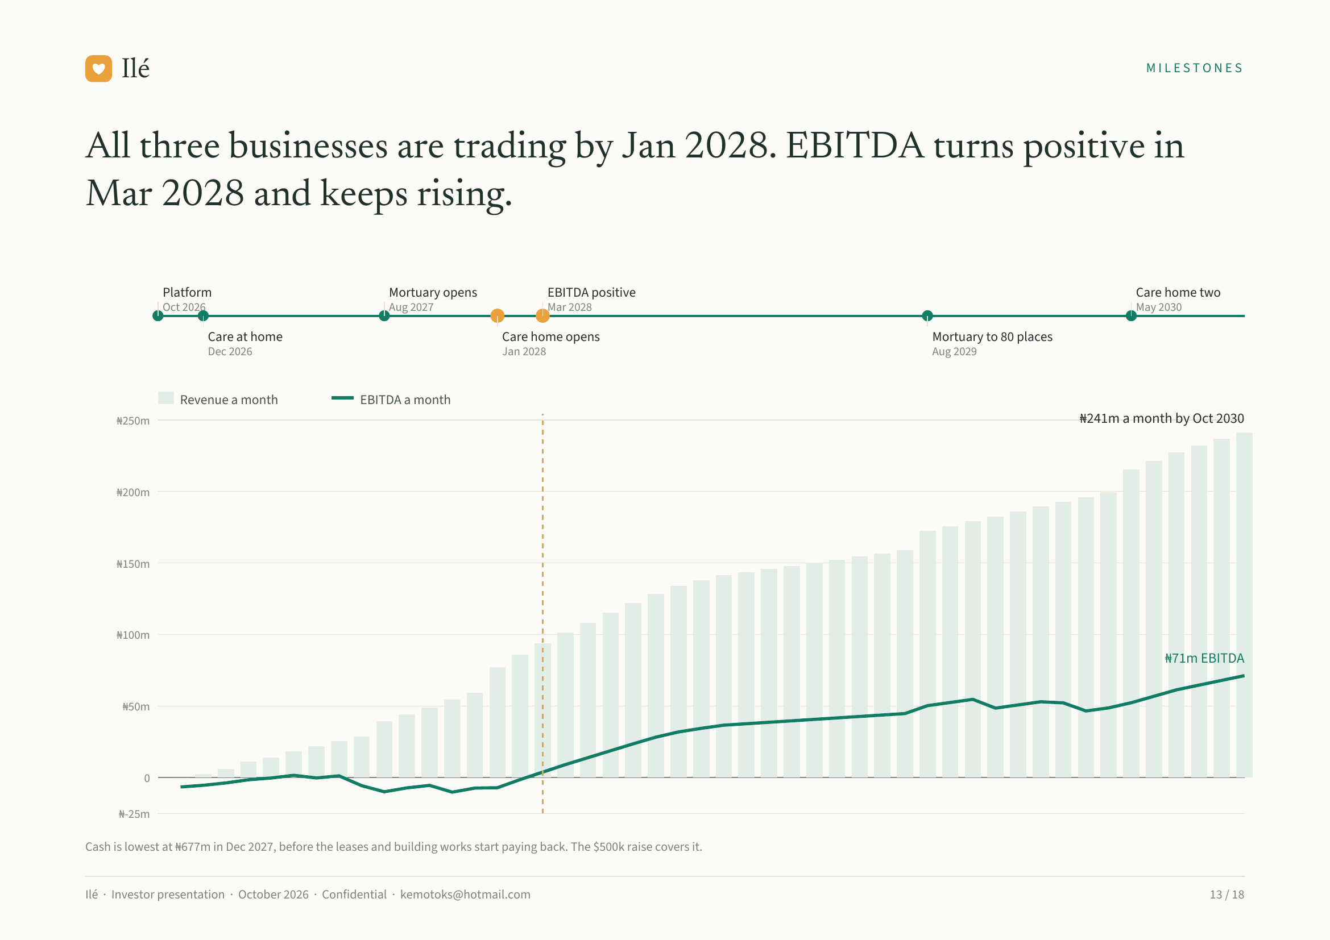
Notes:
Ilé MILESTONES
All three businesses are trading by Jan 2028. EBITDA turns positive in
Mar 2028 and keeps rising.
Platform Mortuary opens EBITDA positive Care home two
Oct 2026 Aug 2027 Mar 2028 May 2030
Care at home Care home opens Mortuary to 80 places
Dec 2026 Jan 2028 Aug 2029
Revenue a month EBITDA a month
₦250m ₦241m a month by Oct 2030
₦200m
₦150m
₦100m
₦71m EBITDA
₦50m
0
₦-25m
Cash is lowest at ₦677m in Dec 2027, before the leases and building works start paying back. The $500k raise covers it.
Ilé · Investor presentation · October 2026 · Confidential · kemotoks@hotmail.com 13 / 18

Slide 14
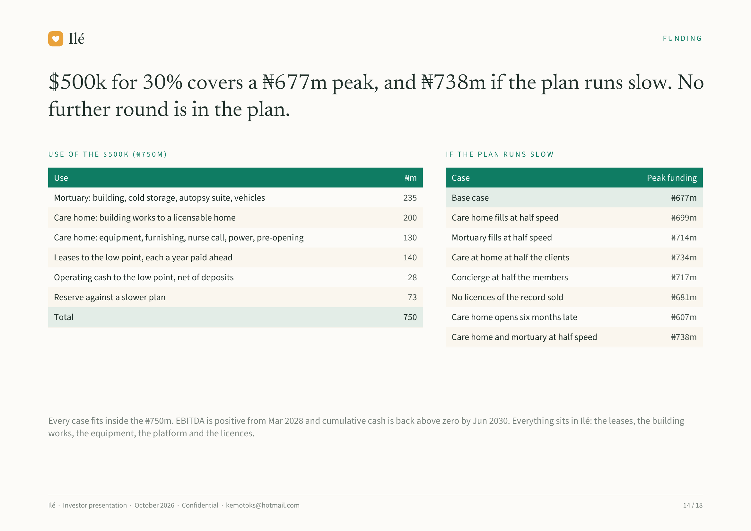
Notes:
Ilé FUNDING
$500k for 30% covers a ₦677m peak, and ₦738m if the plan runs slow. No
further round is in the plan.
USE OF THE $500K (₦750M) IF THE PLAN RUNS SLOW
Use ₦m Case Peak funding
Mortuary: building, cold storage, autopsy suite, vehicles 235 Base case ₦677m
Care home: building works to a licensable home 200 Care home fills at half speed ₦699m
Care home: equipment, furnishing, nurse call, power, pre-opening 130 Mortuary fills at half speed ₦714m
Leases to the low point, each a year paid ahead 140 Care at home at half the clients ₦734m
Operating cash to the low point, net of deposits -28 Concierge at half the members ₦717m
Reserve against a slower plan 73 No licences of the record sold ₦681m
Total 750 Care home opens six months late ₦607m
Care home and mortuary at half speed ₦738m
Every case fits inside the ₦750m. EBITDA is positive from Mar 2028 and cumulative cash is back above zero by Jun 2030. Everything sits in Ilé: the leases, the building
works, the equipment, the platform and the licences.
Ilé · Investor presentation · October 2026 · Confidential · kemotoks@hotmail.com 14 / 18

Slide 15
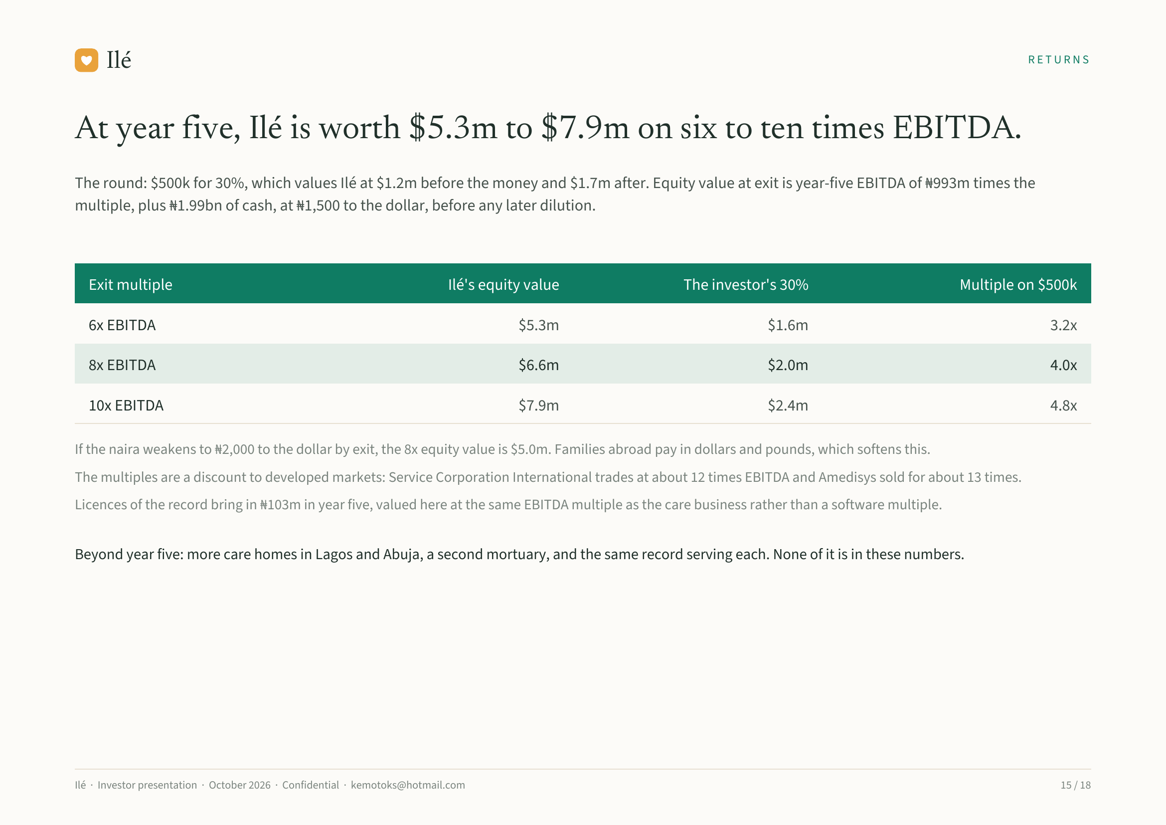
Notes:
Ilé RETURNS
At year five, Ilé is worth $5.3m to $7.9m on six to ten times EBITDA.
The round: $500k for 30%, which values Ilé at $1.2m before the money and $1.7m after. Equity value at exit is year-five EBITDA of ₦993m times the
multiple, plus ₦1.99bn of cash, at ₦1,500 to the dollar, before any later dilution.
Exit multiple Ilé's equity value The investor's 30% Multiple on $500k
6x EBITDA $5.3m $1.6m 3.2x
8x EBITDA $6.6m $2.0m 4.0x
10x EBITDA $7.9m $2.4m 4.8x
If the naira weakens to ₦2,000 to the dollar by exit, the 8x equity value is $5.0m. Families abroad pay in dollars and pounds, which softens this.
The multiples are a discount to developed markets: Service Corporation International trades at about 12 times EBITDA and Amedisys sold for about 13 times.
Licences of the record bring in ₦103m in year five, valued here at the same EBITDA multiple as the care business rather than a software multiple.
Beyond year five: more care homes in Lagos and Abuja, a second mortuary, and the same record serving each. None of it is in these numbers.
Ilé · Investor presentation · October 2026 · Confidential · kemotoks@hotmail.com 15 / 18

Slide 16
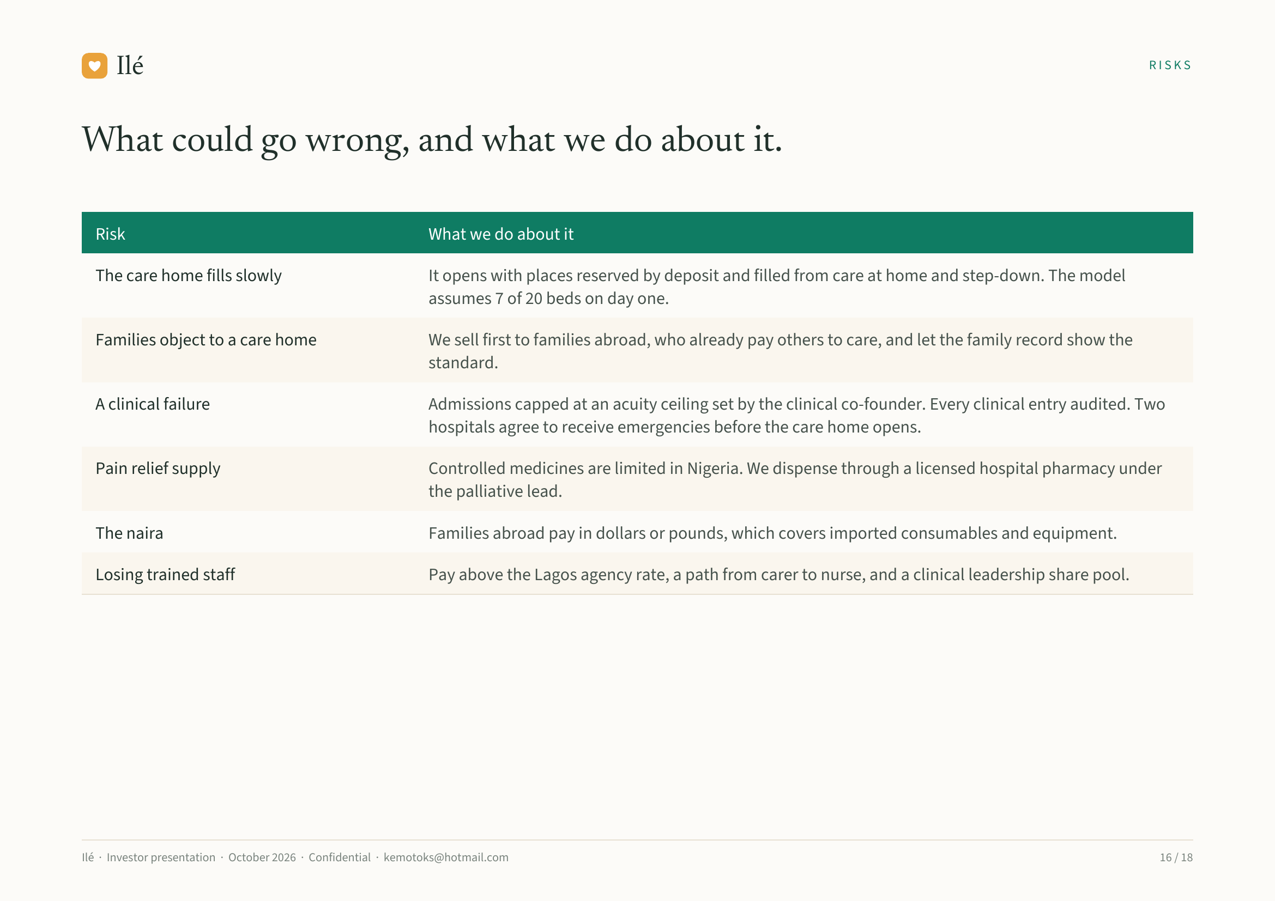
Notes:
Ilé RISKS
What could go wrong, and what we do about it.
Risk What we do about it
The care home fills slowly It opens with places reserved by deposit and filled from care at home and step-down. The model
assumes 7 of 20 beds on day one.
Families object to a care home We sell first to families abroad, who already pay others to care, and let the family record show the
standard.
A clinical failure Admissions capped at an acuity ceiling set by the clinical co-founder. Every clinical entry audited. Two
hospitals agree to receive emergencies before the care home opens.
Pain relief supply Controlled medicines are limited in Nigeria. We dispense through a licensed hospital pharmacy under
the palliative lead.
The naira Families abroad pay in dollars or pounds, which covers imported consumables and equipment.
Losing trained staff Pay above the Lagos agency rate, a path from carer to nurse, and a clinical leadership share pool.
Ilé · Investor presentation · October 2026 · Confidential · kemotoks@hotmail.com 16 / 18

Slide 17
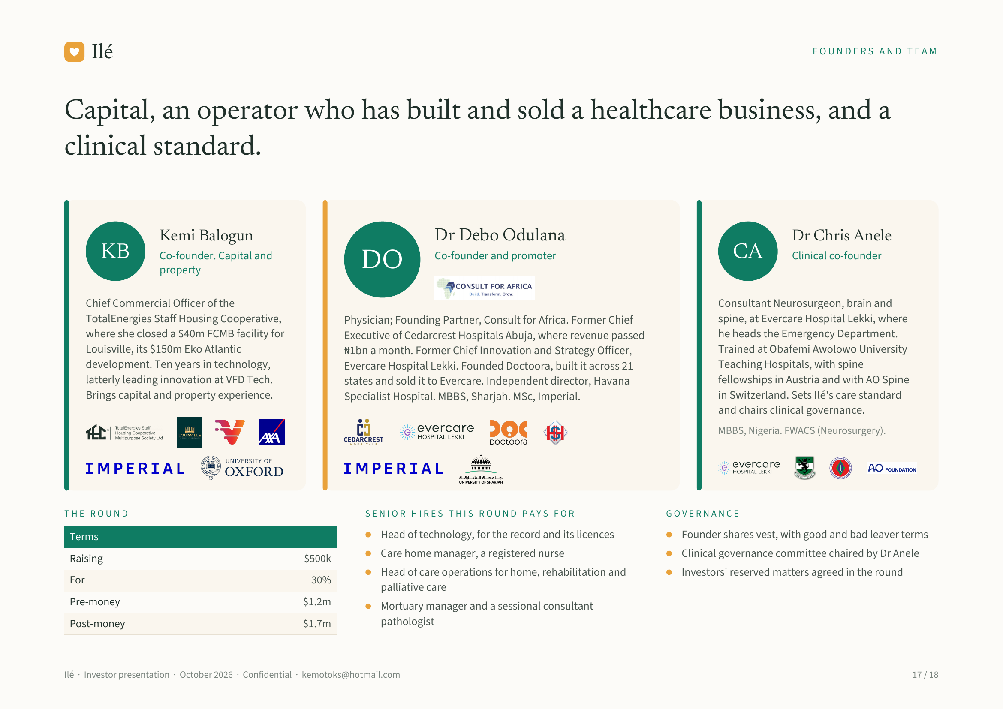
Notes:
Ilé FOUNDERS AND TEAM
Capital, an operator who has built and sold a healthcare business, and a
clinical standard.
Kemi Balogun Dr Debo Odulana Dr Chris Anele
KB Co-founder. Capital and
DO Co-founder and promoter CA Clinical co-founder
property
Chief Commercial Officer of the Consultant Neurosurgeon, brain and
TotalEnergies Staff Housing Cooperative, Physician; Founding Partner, Consult for Africa. Former Chief spine, at Evercare Hospital Lekki, where
where she closed a $40m FCMB facility for Executive of Cedarcrest Hospitals Abuja, where revenue passed he heads the Emergency Department.
Louisville, its $150m Eko Atlantic ₦1bn a month. Former Chief Innovation and Strategy Officer, Trained at Obafemi Awolowo University
development. Ten years in technology, Evercare Hospital Lekki. Founded Doctoora, built it across 21 Teaching Hospitals, with spine
latterly leading innovation at VFD Tech. states and sold it to Evercare. Independent director, Havana fellowships in Austria and with AO Spine
Brings capital and property experience. Specialist Hospital. MBBS, Sharjah. MSc, Imperial. in Switzerland. Sets Ilé's care standard
and chairs clinical governance.
MBBS, Nigeria. FWACS (Neurosurgery).
THE ROUND SENIOR HIRES THIS ROUND PAYS FOR GOVERNANCE
Terms Head of technology, for the record and its licences Founder shares vest, with good and bad leaver terms
Raising $500k Care home manager, a registered nurse Clinical governance committee chaired by Dr Anele
Head of care operations for home, rehabilitation and Investors' reserved matters agreed in the round
For 30%
palliative care
Pre-money $1.2m Mortuary manager and a sessional consultant
Post-money $1.7m pathologist
Ilé · Investor presentation · October 2026 · Confidential · kemotoks@hotmail.com 17 / 18

Slide 18
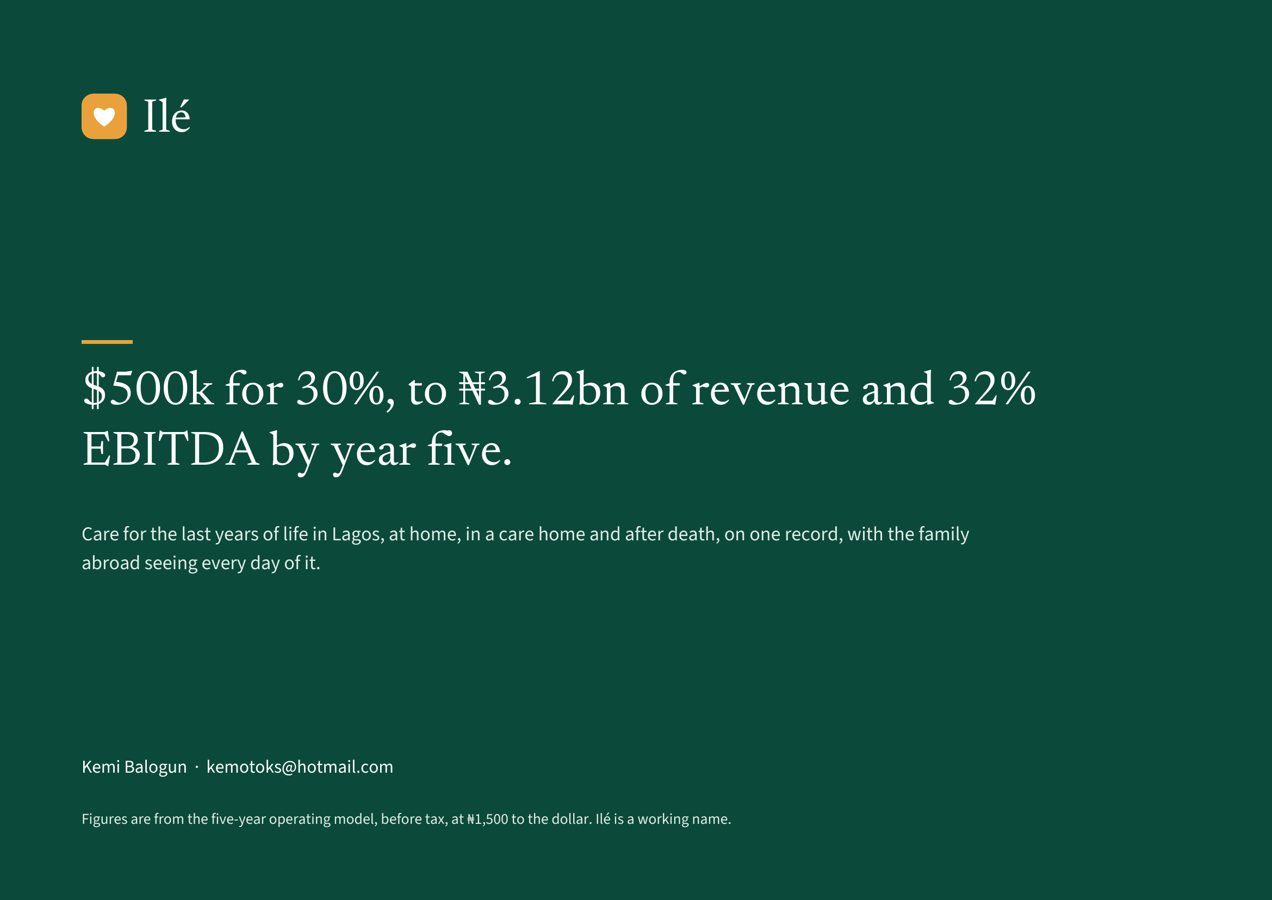
Notes:
Ilé
$500k for 30%, to ₦3.12bn of revenue and 32%
EBITDA by year five.
Care for the last years of life in Lagos, at home, in a care home and after death, on one record, with the family
abroad seeing every day of it.
Kemi Balogun · kemotoks@hotmail.com
Figures are from the five-year operating model, before tax, at ₦1,500 to the dollar. Ilé is a working name.

